Slide 1
Four Types of Racism
Diversity & Inclusion Small Steps. Calvin University

Slide 2
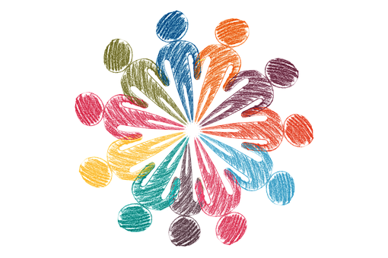
D&I Small Steps
If you have time for a cup of coffee, then you have time for …
Information, Tools, and Strategies to help understand racism, value diversity, and create inclusive communities.

Slide 3
Four Types of Racism

Slide 4
RACISM
the belief that different races possess distinct characteristics, abilities, or qualities, especially so as to distinguish them as inferior or superior to one another.
a belief that race is the primary determinant of human traits and capacities and that racial differences produce an inherent superiority of a particular race
prejudice, discrimination, or antagonism directed against a person or people on the basis of their membership of a particular racial or ethnic group, typically one that is a minority or marginalized.
a doctrine or political program based on the assumption of racism and designed to execute its principles

Slide 5
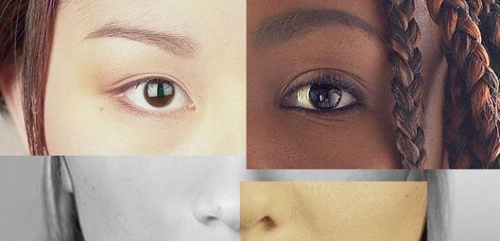

Slide 6
RACISM
Individual-Level
Internalized
Interpersonal
Systemic-Level
Institutional
Structural

Slide 7
RACISM
Individual-Level
Internalized
Interpersonal
Systemic-Level
Institutional
Structural

Slide 8
RACISM
Individual-Level
Internalized
Interpersonal
Systemic-Level
Institutional
Structural

Slide 9
RACISM
Individual-Level
Internalized
Interpersonal
Systemic-Level
Institutional
Structural

Slide 10
Individual-Level RACISM
Internalized Racism
lies within individuals. These are private beliefs and biases about race and racism, influenced by our culture and shaped by our upbringing.

Slide 11
Internalized racism
Internalized racism lies within individuals. These are private beliefs and biases about race and racism, influenced by our culture and shaped by our upbringing.
Internalized racism can take many different forms including:
racial prejudice toward other people of a different race;
internalized oppression, the negative beliefs about oneself by people of color; or
internalized privilege, beliefs about superiority or entitlement by white people.
An example of INTERNALIZED RACISM is the belief that you or others are more or less intelligent, or beautiful, because of your race
Notes:
An example of INTERNALIZED RACISM is the belief that you or others are more or less intelligent, or beautiful, because of your race.

Slide 12
Individual-Level RACISM
Internalized Racism
lies within individuals. These are private beliefs and biases about race and racism, influenced by our culture and shaped by our upbringing.
Interpersonal Racism
occurs between individuals. These are biases that occur when individuals interact with others and their private racial beliefs affect their public interactions.

Slide 13
Interpersonal racism
Interpersonal Racism occurs between individuals. These are biases that occur when individuals interact with others and their private racial beliefs affect their public interactions.
Examples include racial slurs, bigotry, hate crimes, racial violence.
Another common type of interpersonal racism is micro-aggressions.

Slide 14
Individual-Level RACISM
Example 1: An elementary school child chooses the white-blond doll over the dark doll because “she looks prettier”.

Slide 15
Individual-Level RACISM
Example 1: An elementary school child chooses the white-blond doll over the dark doll because “she looks prettier”.
Is this internalized racism OR interpersonal racism?

Slide 16
Individual-Level RACISM
Example 1: An elementary school child chooses the white-blond doll over the dark doll because “she looks prettier”.
INTERNALIZED

Slide 17
Individual-Level RACISM
Example 1: An elementary school child chooses the white-blond doll over the dark doll because “she looks prettier”.
INTERNALIZED
Example 2: The Amy Cooper event in Central Park.

Slide 18
Individual-Level RACISM
Example 1: An elementary school child chooses the white-blond doll over the dark doll because “she looks prettier”.
INTERNALIZED
Example 2: The Amy Cooper event in Central Park.
Is this internalized racism OR interpersonal racism?

Slide 19
Individual-Level RACISM
Example 1: An elementary school child chooses the white-blond doll over the dark doll because “she looks prettier”.
INTERNALIZED
Example 2: The Amy Cooper event in Central Park.
INTERPERSONAL

Slide 20
Individual-Level RACISM
Example 1: An elementary school child chooses the white-blond doll over the dark doll because “she looks prettier”.
INTERNALIZED
Example 2: The Amy Cooper event in Central Park.
INTERPERSONAL
Example 3: A white person is chatting in a group and comments to the Person of Color in the group, “You know I don’t see you as black; you’re just like one of us.”

Slide 21
Individual-Level RACISM
Example 1: An elementary school child chooses the white-blond doll over the dark doll because “she looks prettier”.
INTERNALIZED
Example 2: The Amy Cooper event in Central Park.
INTERPERSONAL
Example 3: A white person is chatting in a group and comments to the Person of Color in the group, “You know I don’t see you as black; you’re just like one of us.”
Is this internalized racism OR interpersonal racism?

Slide 22
Individual-Level RACISM
Example 1: An elementary school child chooses the white-blond doll over the dark doll because “she looks prettier”.
INTERNALIZED
Example 2: The Amy Cooper event in Central Park.
INTERPERSONAL
Example 3: A white person is chatting in a group and comments to the Person of Color in the group, “You know I don’t see you as black; you’re just like one of us.”
INTERPERSONAL

Slide 23
RACISM
Individual-Level
Internalized
Interpersonal
...
...
...

Slide 24
RACISM
Individual-Level
Internalized
Interpersonal
Systemic-Level
...
...

Slide 25
Systemic-Level RACISM
Institutional Racism
occurs within institutions and systems of power. It is the unfair policies and discriminatory practices of particular institutions (schools, workplaces, etc.) that routinely produce racially inequitable outcomes for people of color and advantages for white people.

Slide 26
Institutional Racism
Institutional racism occurs within institutions and systems of power. It is the unfair policies and discriminatory practices of particular institutions (schools, workplaces, etc.) that routinely produce racially inequitable outcomes for people of color and advantages for white people.
Individuals within institutions take on the power of the institution when they reinforce racial inequities.
An example is a school system that concentrates people of color in the most overcrowded schools, the least-challenging classes, and the least-qualified teachers, resulting in higher dropout rates and disciplinary rates compared with that of white students.

Slide 27
Systemic-Level RACISM
Institutional Racism
occurs within institutions and systems of power. It is the unfair policies and discriminatory practices of particular institutions (schools, workplaces, etc.) that routinely produce racially inequitable outcomes for people of color and advantages for white people.
Structural Racism
is racial bias among institutions and across society. It involves the cumulative and compounding effects of an array of societal factors including the history, culture, ideology, and interactions of institutions and policies that systematically privilege white people and disadvantage people of color.

Slide 28
Structural Racism
Structural Racism is racial bias among institutions and across society. It involves the cumulative and compounding effects of an array of societal factors including the history, culture, ideology, and interactions of institutions and policies that systematically privilege white people and disadvantage people of color.
An example is the overwhelming number of depictions of people of color as criminals in mainstream media, which can influence how various institutions and individuals treat people of color with suspicion when they are shopping, traveling, or seeking housing and employment – all of which can result in discriminatory treatment and unequal outcomes.

Slide 29
RACISM
Individual-Level
Internalized
Interpersonal
Systemic-Level
Institutional
Structural

Slide 30
RACISM
Individual-Level
Internalized
Interpersonal
Systemic-Level
Institutional
Structural

Slide 31
RACISM
Individual-Level
Internalized
Interpersonal
Systemic-Level
Institutional
Structural

Slide 32
RACISM
Individual-Level
Internalized
Interpersonal
Systemic-Level
Institutional
Structural

Slide 33
Next Steps
Admit and commit to work on our own internalized racism.
Movies. Put the following on your watch list.
13th
Just Mercy
Selma
The Immortal Life of Henrietta Lacks
Books:
How to be an Anti-Racist. by Ibram X Kendi
I’m Still Here: Black Dignity in a World made for Whiteness. by Austin Channing Brown
Article:
Who gets to be afraid in America? by Ibram X. Kendi
https://www.theatlantic.com/ideas/archive/2020/05/ahmaud-arbery/611539/
Admit and commit.

Slide 34
Next Steps
Engage against acts of interpersonal racism.
Work on recognizing, avoiding, and even intervening when we observe or experience interpersonal racism.
Example: Someone in your circle of influence says something like: I don’t understand all those black people rioting in __. They should all be arrested.
Possible response:
While I do not agree with the destruction and looting that some individuals have participated in amidst the recent protests, there have also been lots of constructive and positive, non-violent protests.
“A riot is the language of the unheard.” MLK
And, in any case, we cannot ignore the root causes for which many people of all races are protesting for: unfair treatment of black and brown people in our society and especially in specific interactions with police and white men highlighted recently by the death of George Floyd and others.
Engage.

Slide 35
Diversity & Inclusion Small Steps
4 types of Racism adapted from:
http://oppressionmonitor.us/2014/01/31/four-types-racism/
Pennylyn Dykstra-Pruim
associate dean for diversity & inclusion
Calvin University

